Slide 1
People

Slide 2
People

Slide 5
Politician

Slide 6
Politician

Slide 7
Politician

Slide 8
People
Politician

Slide 9
People
Politician

Slide 10
People
Politician
Malu

Slide 11
People
Malu
Politician
18 years
Male

Slide 12
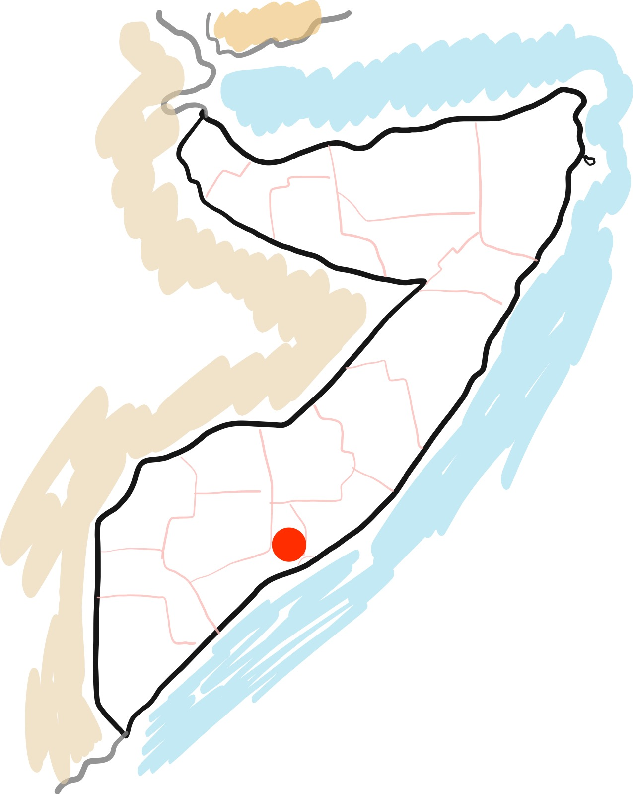
18 years
Male
People
Malu
Mogadishu
Politician

Slide 13
18 years
Male
Mogadishu
People
Malu
Politician

Slide 14
Qualitative
Quantitative
18 years
Male
Mogadishu
People
Malu
Politician

Slide 15
Qualitative
Quantitative
18 years
Male
Mogadishu
People
Malu
Politician

Slide 16
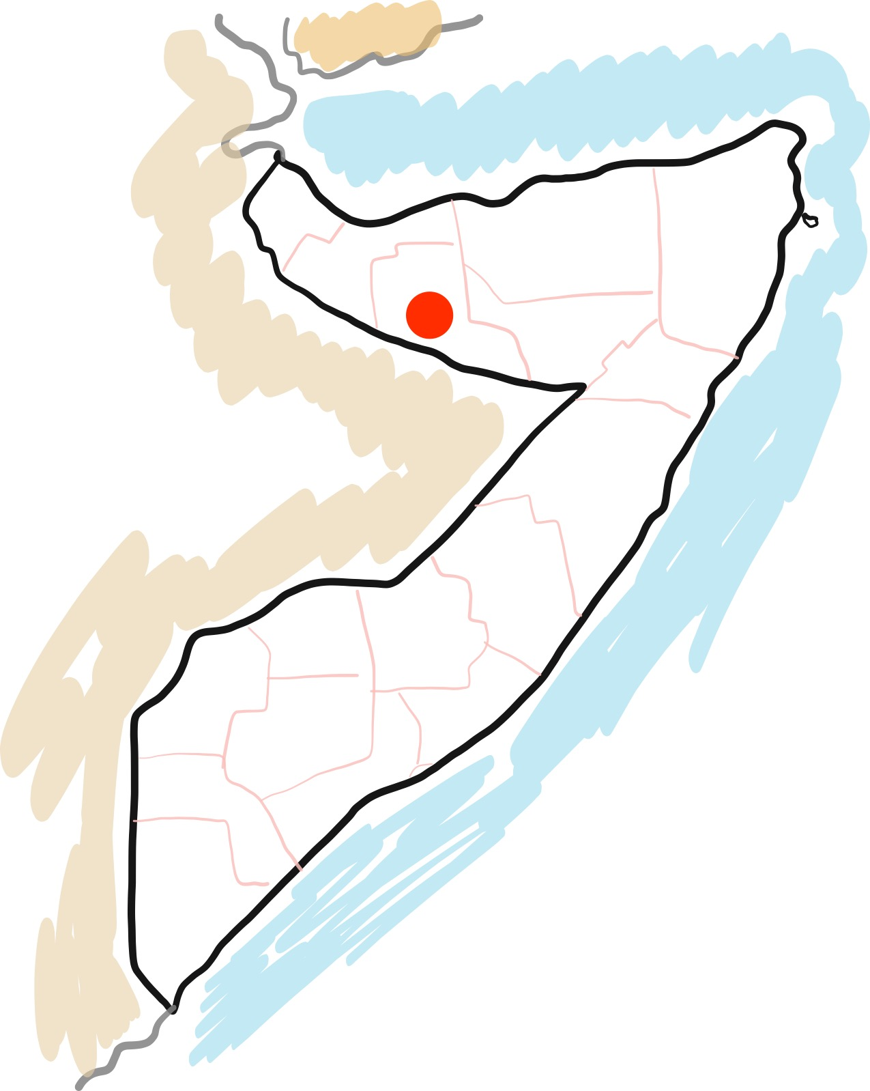
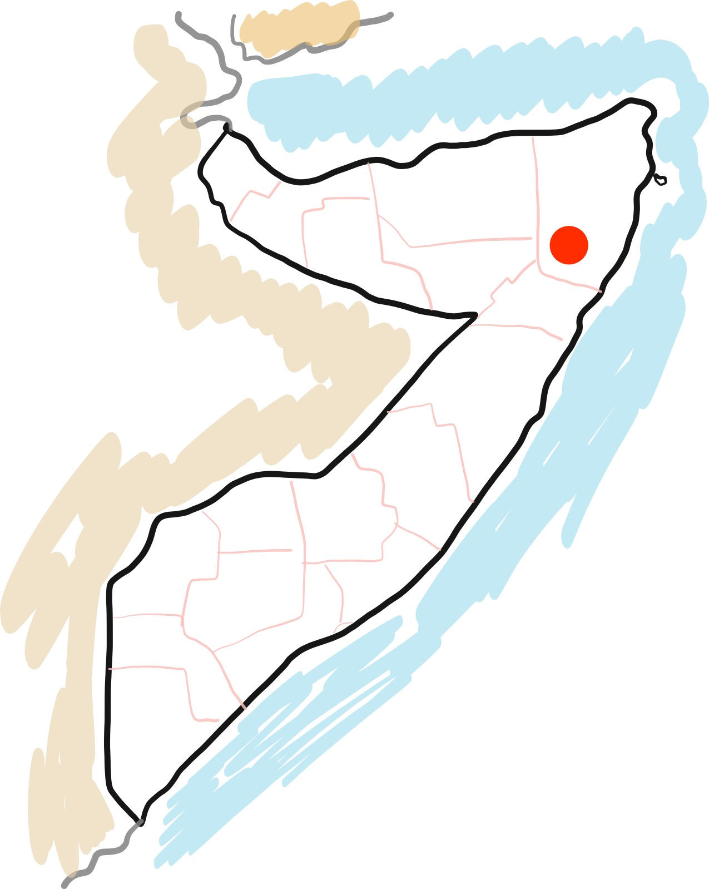

Quantitative
45%
20%
12%
8%
Qualitative
18 years
Male
Mogadishu
﻿
Malu

Slide 17
Quantitative
Qualitative
12%
45%
20%
18 years
Male
Mogadishu
8%
﻿
Malu

Slide 18
Quantitative
Qualitative
18 years
Male
Mogadishu
﻿
Malu

Slide 19
Quantitative
Qualitative
18 years
Male
Mogadishu
﻿
Malu

Slide 20
Quantitative
Qualitative
18 years
Male
Mogadishu
﻿
Malu

Slide 21
Quantitative
Qualitative
18 years
Male
Mogadishu
﻿
Malu

Slide 22
Quantitative
Qualitative
18 years
Male
Mogadishu
﻿
Malu

Slide 23
Quantitative
Qualitative
18 years
Male
Mogadishu
Malu

Slide 24
Quantitative
Qualitative
18 years
Male
Mogadishu
Malu

Slide 25
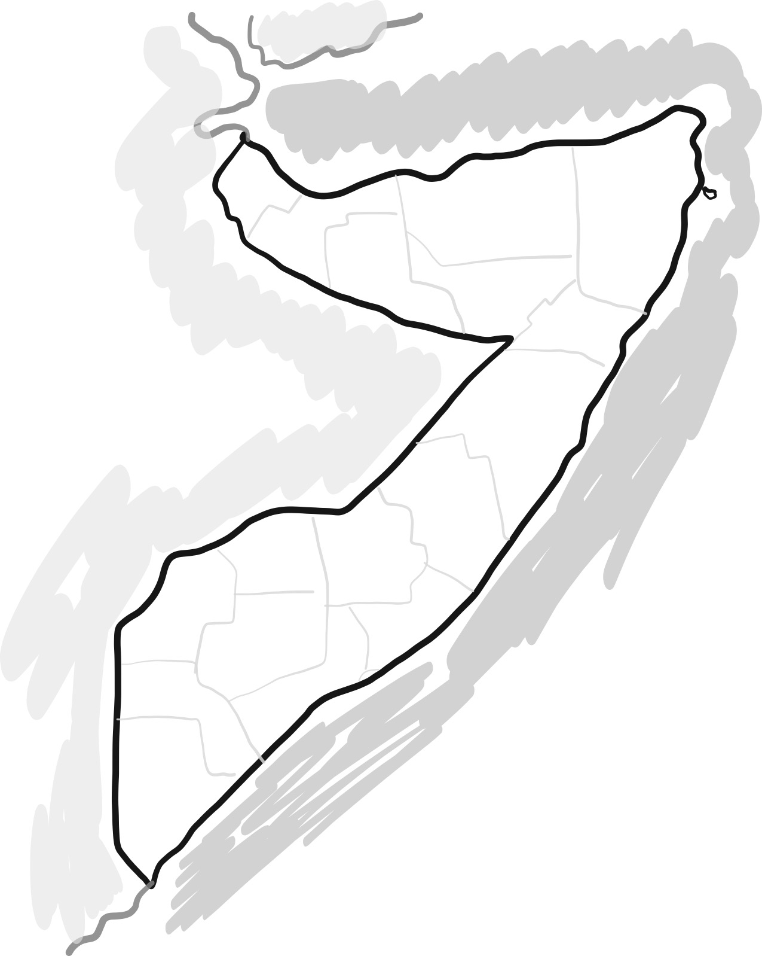
Quantitative
Qualitative
18 years
Male
Mogadishu
Malu

Slide 26
Quantitative
Qualitative
18 years
Male
Mogadishu
Malu

Slide 27


Quantitative
Qualitative
18 years
Male
Mogadishu
Ideation
Malu
Visualization

Slide 28

Quantitative
18 years
Male
Mogadishu
Prototyping
Qualitative
Ideation
Visualization
Malu

Slide 29
Quantitative
18 years
Male
Mogadishu
Qualitative
Prototyping
Ideation
Visualization
Malu

Slide 30
Quantitative
18 years
Male
Mogadishu
Prototyping
Qualitative
Ideation
Malu
Visualization

Slide 31
Quantitative
18 years
Male
Mogadishu
Qualitative
Malu

Slide 32
Quantitative
18 years
Male
Mogadishu
Qualitative
De
mo
Malu

Slide 33
Quantitative
18 years
Male
Mogadishu
Qualitative
De
mo
Malu

Slide 34
Quantitative
Still missing screencast
De
mo

